Slide 1



The first Hub for Developers
MVC
(Model-View-Controller)

Slide 2
Introduction
Web vs Desktop (Develop, Deploy, Update, Debug)
Web Sites vs Web Applications (Apps)
Terminology
URLs – Resources
https://google.com, ftp://ntua.gr/ubuntu, mailto:gpal@best.gr
HTTP – The language
MVC – The pattern
ASP.NET MVC v5.1 – The framework
Mozilla Developer Network (MDN) is your friend
2 / 62

Slide 3
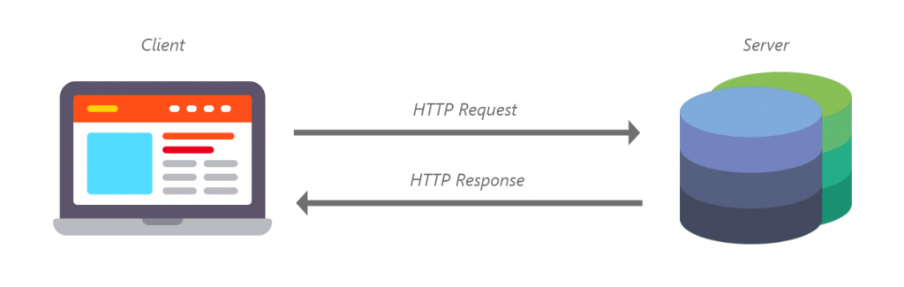
HTTP (1/4) - Introduction
Web Server: What do you think when you hear it?
Physical Machine
Application
Browser: What happens when you hit Enter?
DNS Lookup, retrieve IP from Host Name
Browser (client) opens connection to web server’s address (server)
Client sends request to Server (HTTP Request)
Client receives response from Server (HTTP Response)
Client retrieves content (HTML) renders it
3 / 62

Slide 4
HTTP (2/4) – HTTP Methods (Verbs)
HTTP Verbs convey meaning / intention
GET: Gets a resource. Most common verb. No state change. POST: Post data to app -> Action taken (e.g. register account) PUT: Update (replace). Replace current resource with payload
PATCH: Update (modify). Apply partial modification to resource
DELETE: Delete resource
4 / 62

Slide 5
Demo
GET https://jsonplaceholder.typicode.com/posts (all posts)
GET https://jsonplaceholder.typicode.com/posts/1 (get post with id 1, note plural)
GET https://jsonplaceholder.typicode.com/posts/1/comments (get comments of post w/ id 1)
GET https://jsonplaceholder.typicode.com/posts?userId=1
(filtering by userId, other than ids)
5 / 62

Slide 6
HTTP (3/4) – HTTP Status Codes
(OK): Request Succeeded.
(Created): Resource created (e.g. after POST)
2xx Successful Responses
301/308 (Moved permanently) 308 guarantees same verb 302/307 (Moved temporarily) 307 guarantees same verb 304 (Not Modified) Send header, but no content (e.g. cached)
3xx Redirection messages
(Bad Request): Server cannot understand request (Domain validation, Bad syntax, Missing Params)
(Unauthorized): Missing or invalid auth headers.
403 (Forbidden): Authenticated, but has no permissions.
404 (Not Found): Resource not found (or masked 401/403)
4xx Client Errors
500 (Internal Server Error): Code Exception.
502 (Bad gateway): Gateway got invalid response
503 (Service unavailable): Server down/overloaded
504 (Gateway timeout): Gateway got no response
5xx Server Errors
6 / 62

Slide 7
HTTP (4/4) – HTTP Request Sample
POST / HTTP/1.1
Host: myserver.com
Content-Type: application/json
Content-Length: 56
{
“firstname”: “Johnny”, “lastname”: “Mnemonic”
}
HTTP Verb
HTTP Headers
HTTP Body
7 / 62

Slide 8

ASP.NET MVC
Asp.Net MVC1 Released on Mar 13, 2009
MVC Pattern architecture with WebForm Engine
Asp.Net MVC2 Released on Mar 10, 2010
Strongly typed HTML helpers means lambda expression based Html Helpers
ASP.NET MVC3 Released on Jan 13, 2011
Razor Engine
ASP.NET MVC 4 Released on Aug 15, 2012
ASP.NET Web API - Mobile - Azure
ASP.NET MVC 5 Released on 17 October 2013
ASP.NET Core 1.0 Released On 27 June 2016 (currently 2.2)
8 / 62
Notes:
Model–view–controller (MVC) is a software architectural pattern for implementing user interfaces.
It divides a given software application into three interconnected parts, so as to separate internal representations of information from the ways that information is presented to or accepted from the user.
Introduced at Xerox Parc in the 1970s

Slide 9
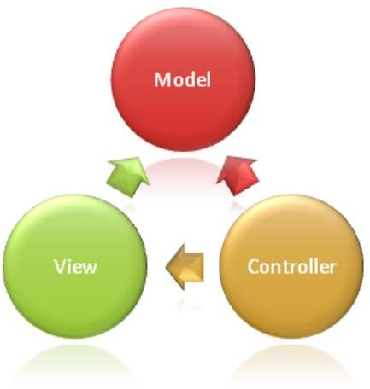
MVC (Model – View – Controller) Architectural Pattern
Model–view–controller (MVC) is a software architectural pattern for implementing user interfaces.
It divides a given software application into three interconnected parts, so as to separate internal representations of information from the ways that information is presented to or accepted from the user.
Introduced at Xerox Parc in the 1970s
9 / 62
Notes:
Model–view–controller (MVC) is a software architectural pattern for implementing user interfaces.
It divides a given software application into three interconnected parts, so as to separate internal representations of information from the ways that information is presented to or accepted from the user.
Introduced at Xerox Parc in the 1970s

Slide 10
Models, Views, and Controllers
What does MVC look like?
Request
Controller
Controller
Retrieves Model
“Does Stuff”

Model

Response
View
View
Visually represents
the model

Notes:
Students will learn more about Entity Framework and data access in Module 2.
Students will learn more about the ASP.NET Routing Engine in Module 7.
20486A
01: Exploring ASP.NET MVC 4

Slide 11
MVC (Model – View – Controller)
Model: Application data and behaviour in terms of its problem domain. (an app to be functional needs:data and business logic)
Example: Movie, Customer etc.
Controllers: Responsible for handling an HTTP request.
Ex. :http://vidly.com/movies → MoviesController
Views: Data needs to be displayed, in different formats (e.g. web/mobile). Typically, the HTML markup that we display to the user.
Router: Not in the acronym but always there. Select the correct controller to handle a request Ex. Router resolves http://vidly.com/movies → MoviesController
11 / 62

Slide 12
MVC (Model – View – Controller) Architectural Pattern
View, Controller depend on model
Model depends on neither
Controllers shouldn't be overly complicated. Mainly routing.
12 / 62

Slide 13
Seems complicated. What’s the point?
Every web application needs some structure
MVC helps you stay organized, start to finish
Often end up with less code, not more
Smoother learning curve as your project grows

Slide 14
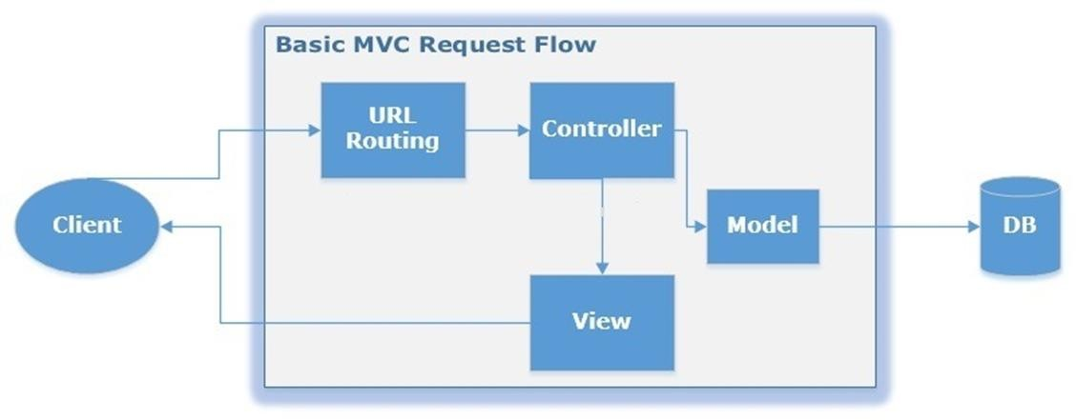
MVC (Model – View – Controller)

Slide 15
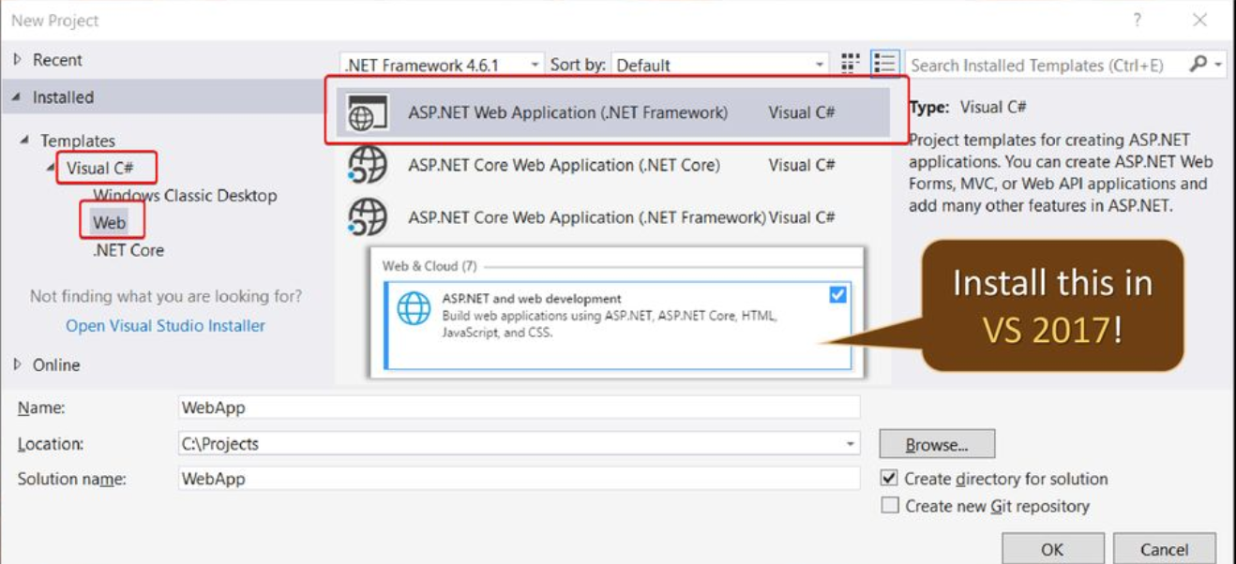
ASP.NET MVC – Hands On – First App

Slide 16
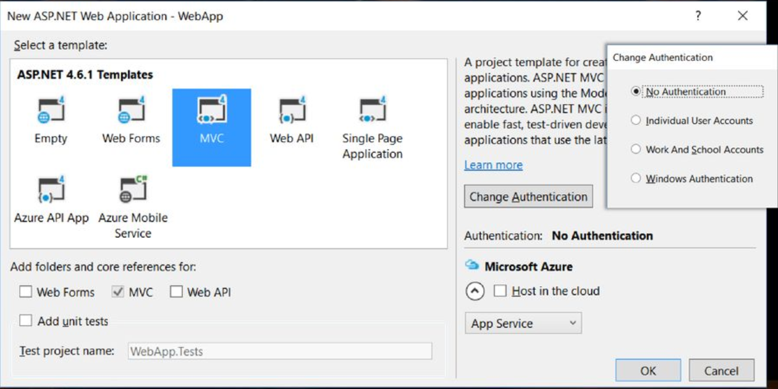
ASP.NET MVC – Hands On – First App

Slide 17
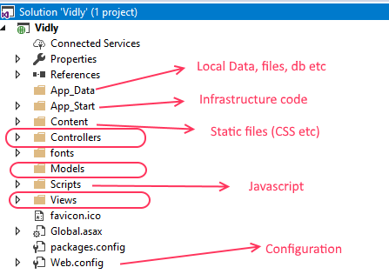
ASP.NET MVC – Hands On – Overview

Slide 18
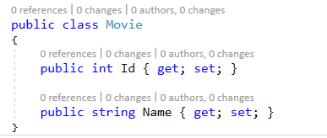
ASP.NET MVC – Hands On – Add Model
Add New Item In Model folder named: Movie.cs

Slide 19
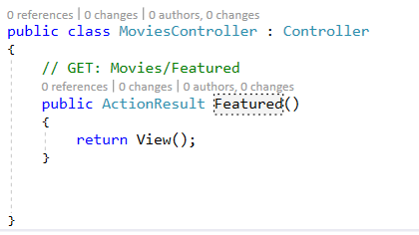
ASP.NET MVC – Hands On – Add Controller
We want to represent a featured movie: vidly.com/Movies/Featured
Add New Item inside Controllers MoviesController

Slide 20
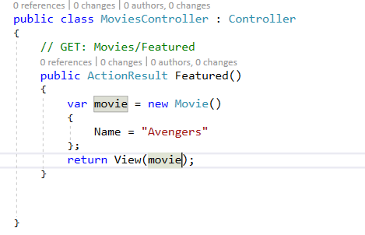
ASP.NET MVC – Hands On – Add Controller
Return data from Controller

Slide 21
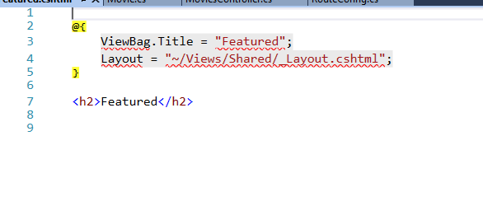
ASP.NET MVC – Hands On – Add View
Adding View into Views→Movies folder
Featured.cshtml

Slide 22
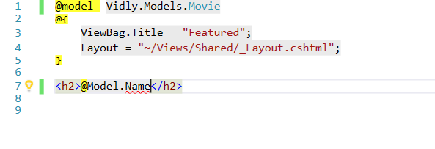
ASP.NET MVC – Hands On – Passing data to View
Adding Model definition on top
Display Title

Slide 23
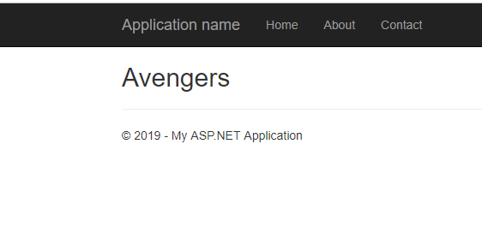
ASP.NET MVC – Hands On – Running All together
Press Control – f5
Conguratulations! Your first ASP.NET has been completed!!!!

Slide 24
ASP.NET MVC – In Action – MovieStore App
A web application for a video rent store:
Membership
Rentals
Inventory

Slide 25

Models What is a Model? Creating Models Advanced Model Concepts

Slide 26
What is a Model?
A class
No really, that’s it. It’s just a class.
We promise – it’s just a class.

Slide 27
ASP.NET MVC – Model
public class Movie
{
public int Id { get; set; }
public string Title { get; set; }
public DateTime ReleaseDate { get; set; } publc string Genre { get; set; }
public decimal Price { get; set; }
}

Slide 28
Preparing Models
Attributes
“Decorate” properties
Available Attributes
DataTypeAttribute
DisplayAttribute
Validation
RequiredAttribute
StringLengthAttribute
RegularExpressionAttribute
CompareAttribute

Slide 29
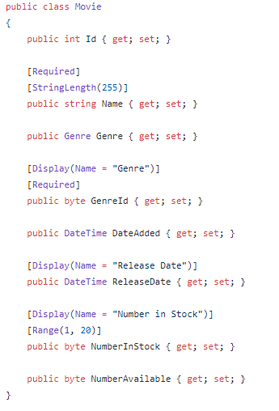
ASP.NET MVC – In Action – Vidly - Models
Model represents domain specific data and business logic in MVC architecture.
Movie

Slide 30
Data Types
Validation
Input controls
HTML5
Available Data Types
CreditCard
Currency
EmailAddress
Password
Url

Slide 31
ASP.NET MVC – Model Validation
Required: [Required]
Data Types: [DataType(DataType.*)]
Format:
[CreditCard], [EmailAddress], [Phone], [Url]
[Range]: Validates value falls within given range.
[RegularExpression]: Validates data matches specified RegEx.
[StringLength]: Validates string has at most given max length.
Other:
[Compare]: Validates two properties in a model match.
[Remote]: Server-side call

Slide 32
ASP.NET MVC – In Action
Hands On
Customer
Id
Name
Birthdate
IsSubscribedToNewsletter
MembershipType

Slide 33
Controllers Adding Actions Model Binding Filters Vanity URLs Controller Best Practices

Slide 34
Adding Actions
Controllers are classes
Actions are methods
Creating an action involves adding a method to a class

Slide 35
Action Signature
Return Types
ActionResult
FileResult
JsonResult
ViewResult
Parameters
Normal parameters
MVC model binding

Slide 36
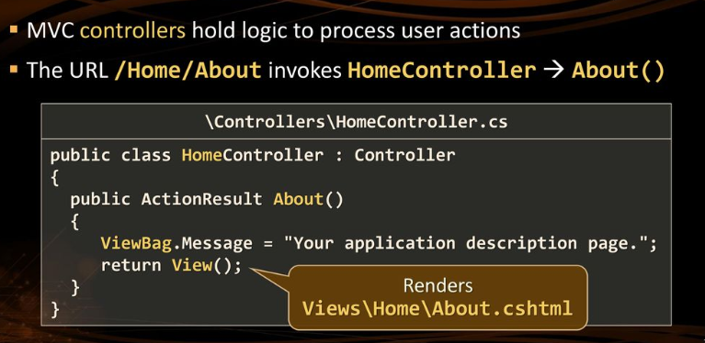
ASP.NET MVC - Controller

Slide 37
ASP.NET MVC - Controllers
Controllers/ folder
Inherit Controller (view) or ControllerBase (no view)
Return IActionResult or ActionResult<T>
return:
View(),
Content(),
Empty(),
File(),
Json(),
Redirect()
PartialView(), ViewComponent()
Should Validate Data?
14 / 62

Slide 38
Get and Post
Create/Update/Delete are typically two step operations
Present the form
Accept the input
Create two actions
Form presentation via HttpGet (default)
Accept data via HttpPost

Slide 39
Default Model Binder
“It just works” – Jon Galloway
Uses the name attribute of input elements
Automatically matches parameter names for simple data types
Complex objects are mapped by property name
Complex properties use dotted notation
<input type="text" name=“Customer.Notes" />
Movie
MovieId
Title
Length
Year
Customer
CustomerId
FirstName
LastName
Notes

Slide 40
Controlling Model Binding
Imagine the following model
Need
Create a form to title
Challenge
Default model binder automatically binds all inbound properties
Movie
MovieId
Title

Slide 41
Solutions
Simplest
Use the bind attribute to indicate which properties to bind
Edit([Bind(Include = “MovieId,Title,Length")] Movie movie)
Other solutions
Create a view model
Create a custom model binder

Slide 42
Scaffolding
Generates controllers and views based on models
Built with common ASP.NET Scaffolding system

Slide 43
ASP.NET MVC – In Action – Vidly - Controller
MoviesController
Index
Details
Create
Update
Delete

Slide 44
Routing

Slide 45
ASP.NET MVC - Routing
Conventional Routing:
Convention for URLs: {controller}/{action}/{id}
Execute in order defined
Controller/Action name do play role.
Attribute Routing:
Define routes closer to actions.
Greater flexibility/control (more code).
Controller/Action name don’t play role.
[Route], [HttpGet], [HttpPost], …
Mixed Routing: Default conventional,
unless [Attribute] used (overrides)

Slide 46
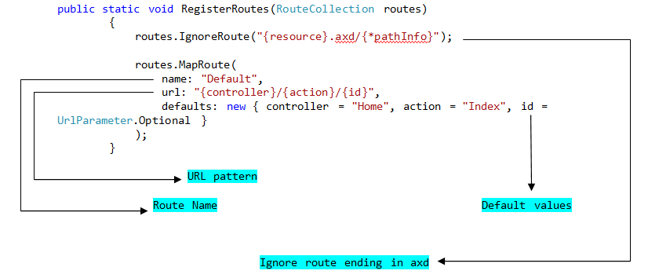
How it works

Slide 47
Views How Views are Found Views and Models Razor Syntax HtmlHelper Layouts

Slide 48
Finding Views
“It just works” – Jon Galloway
Views reside in the Views folder
Subfolders
Name of the controller
Shared

Slide 49
View Resolution in Action
public class MoviesController : Controller { public ActionResult Index() { return View(); } }
Look for a view named Index in a folder named Movies
Look for a view named Index in a folder named Shared
Error

Slide 50
View Resolution in Action Again
public class AlbumController : Controller { public ActionResult Index() { return View("Default"); } }
Look for a view named Default in a folder named Album
Look for a view named Default in a folder named Shared
Error

Slide 51
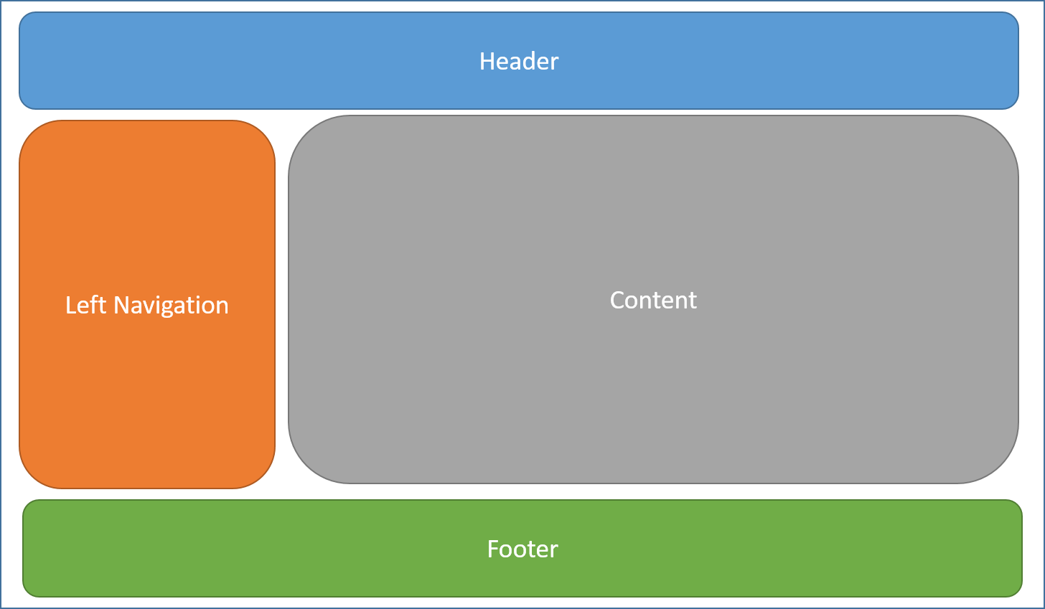
ASP.NET MVC – Views (Layout Example)

Slide 52
ASP.NET MVC - Views
Views/ folder
Display data, Interacts with User (quick validation)
.cshtml files, (default: Index.cshtml)
_Layout: Layout page: DRY, provides consistency
must: RenderBody(), may: RenderSection()
_ViewStart: Code that runs before every page
_ViewImports: Using directives / Tag Helpers /
DI for all pages

Slide 53
Views and Models
Views have a Model property
Type is set by @model declaration
Note the CaSiNg
Advanced note
Views do not need to have a typed model
Useful for creating dynamic views

Slide 54
ASP.NET MVC – Passing data to Views
Loosely-typed: ViewData[“Key”] or ViewBag.Key
Avoid! Use sparingly, e.g. for Title
Strongly-typed: View Models
Recommended! More structured

Slide 55
Razor Syntax
@ indicates server-side code
MVC runtime determines meaning of @ based on context
<a href="mailto:me@demo.com"> generates appropriate HTML
Use @@ for @

Slide 56
ASP.NET MVC – In Action – Vidly - Views
Movies
Index
Details
Create
Update
Delete

Slide 57
ASP.NET MVC – Razor (C# in HTML)
Can be mixed
<p>@DateTime.Now</p>
Code blocks
@{
var quote = "The future depends on what you do today.";
}
<p>@quote</p>
Control Logic
@foreach, @for, @while, @do
@if, else, else if, @switch
Reference Model from Controller
@model

Slide 58
HtmlHelper
Helps generate HTML
Uses attributes on model
Display names
Formatting
Input elements

Slide 59
HtmlHelper and Lambdas
@Html.DisplayFor(model => model.Name)
MVC uses reflection
Reflection isn’t evil!
Helper methods need the property, not the value
@Html.DisplayFor(Model.Name) would pass the value of Name
Consider @Html.DisplayFor(m => m.Name) for easier reading

Slide 60
Displaying Data
DisplayNameFor
DisplayName attribute
Display attribute, Name property
DisplayFor
Uses DisplayFormat (if applicable)

Slide 61
Creating Forms
HtmlHelper.BeginForm()
Why not just use a form element?
URLs can always change
Parameters
Action name
Controller name
Form method
Get
Post

Slide 62
Accepting Input
LabelFor
Creates a label element
Useful for touch
InputFor
Creates input element
Uses HTML5 based on DataType attribute

Slide 63
Validation
ValidationMessageFor
Display error message next to text box
ValidationSummary
Display all error messages in one location

Slide 64
Organization and Consistency
Use layouts to ensure consistent page structure
Layout methods
RenderBody()
Renders anything in a view not in a section
RenderSection(name, required)
Allow views to add specific sections
Scripts
Banners
Sidebars
Use @section name to create section in view
Note the casing

Slide 65

Thank You!

Slide 66
Visual Studio Web Tools
Browser Link
Zen Coding
IntelliSense
jQuery
Angular
Knockout
Etc.
VS Web Essentials
Side Waffle

Slide 67
Bonus: Create Model from Existing Db
// ef core for db provider you want
Install-Package EntityFramework.SqlServer
// create model from db
Install-Package EntityFramework.CodeTemplates.CSharp
// asp.net core scaffolding tools
Install-Package Microsoft.VisualStudio.Web.CodeGeneration.Design

Slide 68
Bonus: Create Model from Existing Db
Add DbContext in DI services (ConfigureServices):
var connection = @"Server=(localdb)\mssqllocaldb; Database=Movies; Trusted_Connection=True; ConnectRetryCount=0";
services.AddDbContext<MoviesContext>(
options => options.UseSqlServer(connection));
Fine-tune model using EF Core Fluent API (precedence over Attributes): https://docs.microsoft.com/en-us/ef/core/modeling/

